Slide 1
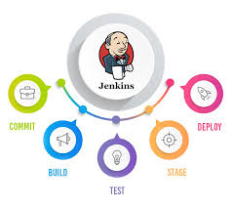

Slide 2
AGENDA
TRADITIONAL INTEGRATION SYSTEM
CONTINUOUS INTEGRATION
CIT – VALUE ADD
JENKINS
BENEFITS & USERS & AWARDS
OTHER CIT TOOLS
PLUG-INS
INDUSTRY ADOPTION
CIT CASE-STUDY: NOKIA NIGHTLY BUILD
JENKINS SETUP & LAUNCH
CI-CD PIPELINE

Slide 3
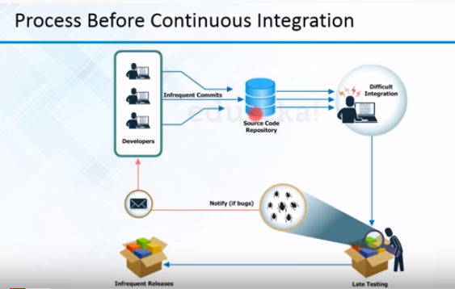
TRADITIONAL INTEGRATION SYSTEM

Slide 4
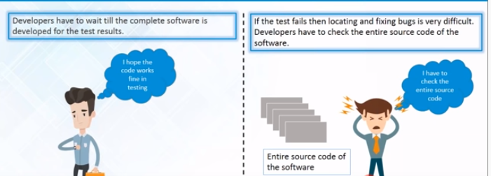
TRADITIONAL INTEGRATION SYSTEM
REAL TIME CHALLENGES:
TEST RESULT : Have to wait till all Developers complete their task to perform Test to Whole build
DEBUG: Since we build as a single whole build, Developer has to undergo into entire source code to identify his problematic area. Time consuming.
Software Delivery Slowness: Yes, due to people dependencies and Delay in receiving Test result
Feedback to Developer: Infrequent feedback to developers
Impact: It result in the Infrequent Deployment / Releases on Production

Slide 5
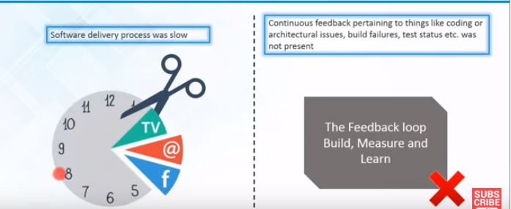
TRADITIONAL INTEGRATION SYSTEM

Slide 6
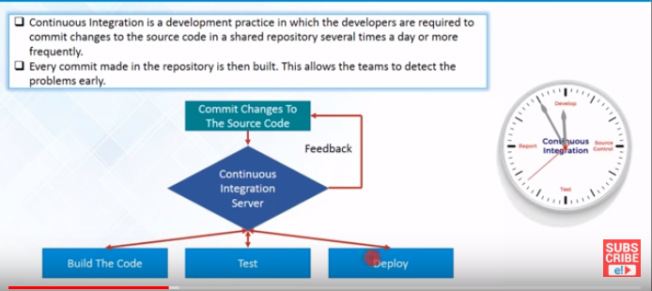
CONTINUOUS INTEGRATION

Slide 7
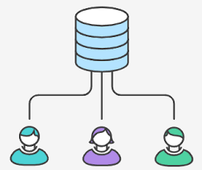
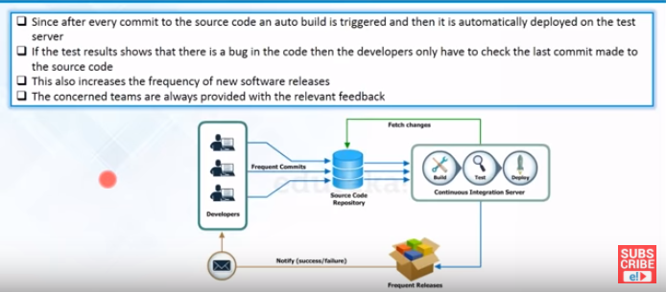
CIT – VALUE ADD

Slide 8
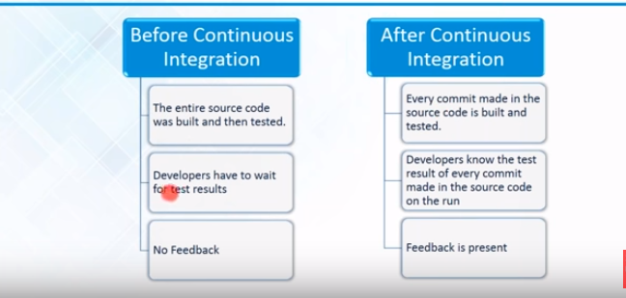
CIT – VALUE ADD

Slide 9
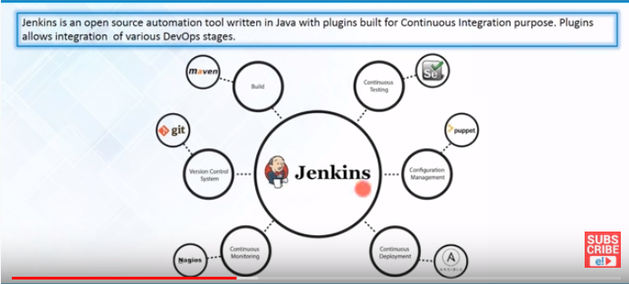

JENKINS

Slide 10
JENKINS
HISTORY
2005 - Hudson was first release by Kohsuke Kawaguchi of Sun Microsystems
2010 – Oracle bought Sun Microsystems due to a naming dispute, Hudson was renamed to Jenkins Oracle continued development of Hudson (as a branch of the original)
WHAT IS JENKINS?
Jenkins is an open-source, Continuous Integration Tool.
written in Java.
Server-based system running in a servlet container such as Apache Tomcat.
This is an award-winning application that monitors executions of repeated jobs, such as building a software project or jobs run by cron.
Jenkins has job types such as Freestyle, External, Multi-config.
Jenkins has core functionality and flexibility allow it to fit in a variety of environments and can help streamline the development process for all stakeholders involved.
WHY JENKINS?
Jenkins is a highly configurable system by itself.
The additional community developed plug-in provide even more 'Flexibility'.
By combining Jenkins with Ant, Gradle, or other Build Automation tools, the possibilities are limitless.
Plug-ins enables integration with any kind of environments

Slide 11
JENKINS
BENEFITS
Generate test reports
Integrate with many different Version Control Systems
Push to various artifact repositories
Deploys directly to production or test environments
Notify stakeholders of build status and many much..
Jenkins also do an Deployment via Master and Slaves Method, but it is not an recommended process
USERS
LinkedIn
NASA
NETFLIX
EBay
Michelin
Mozilla foundation
AWARDS
InfoWorld Bossies Award, 2011
O'Reilly Open-Source Award, 2011
ALM&SCM, SDTimes 100, 2010, 2011
GlassFish Community Innovation Award 2008
Duke's Choice Award 2008

Slide 12

OTHER CIT TOOLS
Experiment: Analyze the key differences between each tools

Slide 13
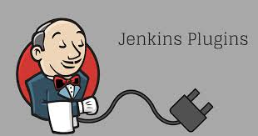
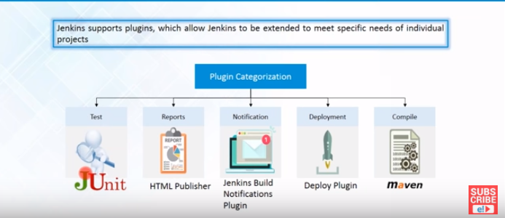
PLUG-INS
Plugins are the primary means of enhancing the functionality of a Jenkins environment to suit organization- or user-specific needs. There are over a 2500 different plugins which can be installed on a Jenkins master and to integrate various build tools, cloud providers, analysis tools, and much more. This is an daemon process, it runs in backend, it won’t directly interact with end user

Slide 14
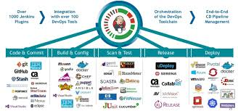
PLUG-INS

Slide 15
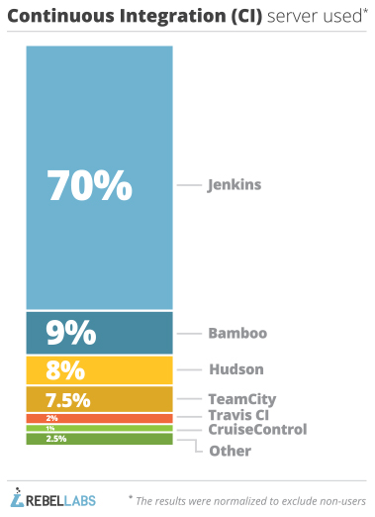
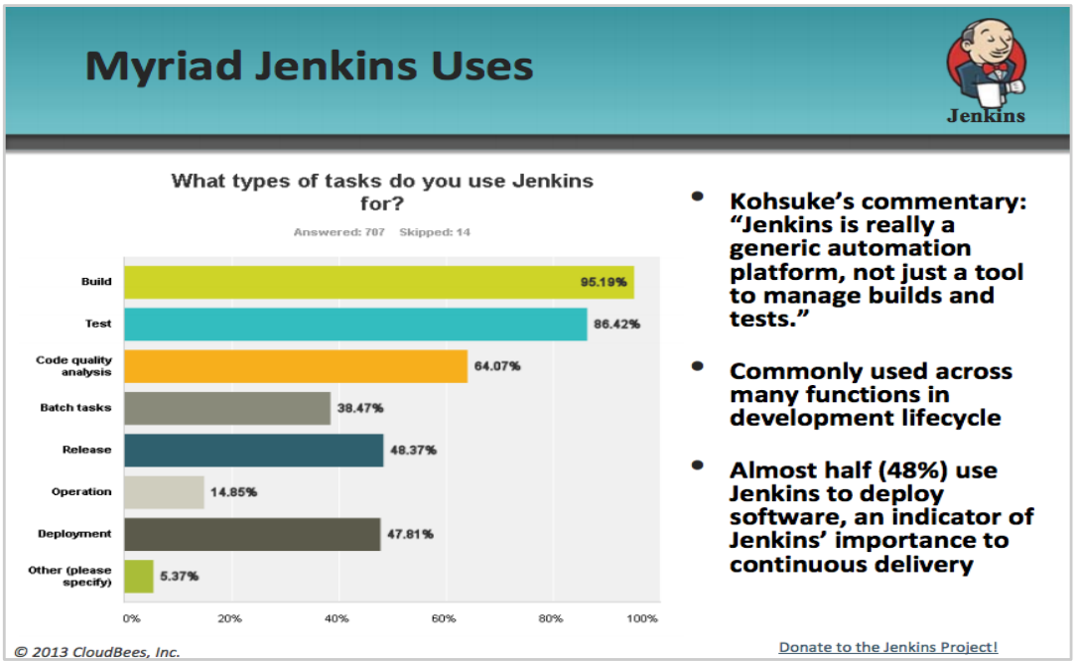
INDUSTRY ADOPTION

Slide 16
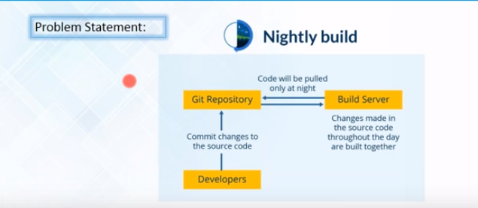
CIT CASE-STUDY: NOKIA NIGHTLY BUILD
CHALLENGES
TEST RESULT
DEBUG
SLOW IN DELIVERY
NO FREQUENT FEEDBACK

Slide 17
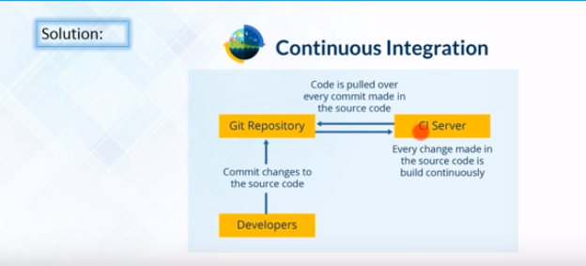
CIT CASE-STUDY: NOKIA NIGHTLY BUILD
Through Continuous Integration, All listed challenges has been fixed.

Slide 18
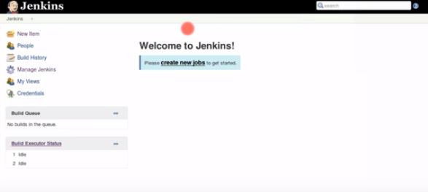
JENKINS SETUP & LAUNCH
JENKINS -SETUP
JENKINS DASHBOARD

Slide 19
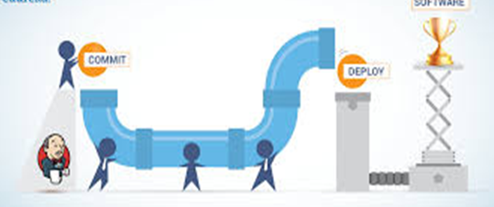
CI-CD PIPELINE
WHAT IS CI CD PIPELINE
Jenkins Pipeline (or simply "Pipeline") is a suite of plugins which supports implementing and integrating continuous delivery pipelines into Jenkins. ...Jenkins Pipeline provides an extensible set of tools for modeling simple-to-complex delivery pipelines "as code“.
Pipeline Types: Build and Delivery Pipeline

Slide 20
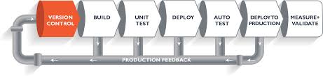
CI-CD PIPELINE
CD – CONTINUOUS DEPLOYMENT

Slide 21
THANK YOU

